Slide 1
TOPIC 4: Decision Structures

Slide 2
Learning outcome
4.1 Python if statement
4.2 Python if-else statement
4.3 Python if-elif-else statement
4.4 Exception handling
4.5 Boolean expressions and data type
4.6 Sequences of decisions and nested decision
structures

Slide 3
4.1 Python if statement
A control structure is a logical design that controls the order in which a set of statements execute.
An if statement is used as a form of conditional programming; something you probably do every day in the real world. That is, you need to decide whether you are going to have tea or coffee or to decide if you will have toast or a muffin for breakfast etc. In each of these cases you are making a choice, usually based on some information such as I had coffee yesterday, so I will have tea today.

Slide 4
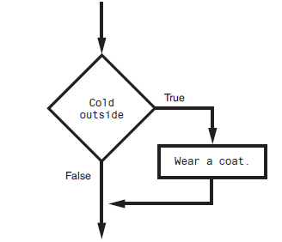
4.2 Python if-else statement
In the flowchart, the diamond symbol indicates some condition that must be tested. In this case, we are determining whether the condition Cold outside is true or false. If this condition
is true, the action Wear a coat is performed. If the condition is false, the action is skipped. The action is conditionally executed because it is performed only when a certain condition is true.

Slide 5
if condition:
# code block to execute if the condition is true
else:
# code block to execute if the condition is false (optional)
x = 10
if x > 5:
print("x is greater than 5")
else:
print("x is not greater than 5")
age = 18
if age >= 18:
print("You are eligible to vote.")
else:
print("You are not eligible to vote.")

Slide 6
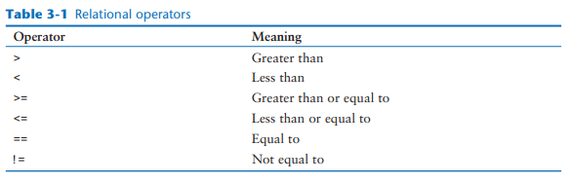
RELATIONAL OPERATORS

Slide 7
1 # This program gets three test scores and displays
2 # their average. It congratulates the user if the
3 # average is a high score.
4
5 # The HIGH_SCORE named constant holds the value that is
6 # considered a high score.
7 HIGH_SCORE = 95
8
9 # Get the three test scores.
10 test1 = int(input('Enter the score for test 1: ' ))
11 test2 = int(input('Enter the score for test 2: ' ))
12 test3 = int(input('Enter the score for test 3: ' ))
13
14 # Calculate the average test score.
15 average = (test1 + test2 + test3) / 3
16
17 # Print the average.
18 print(f'The average score is {average}.')
20 # If the average is a high score,
21 # congratulate the user.
22 if average >= HIGH_SCORE:
23 print('Congratulations!’)
24 print('That is a great average!’)
Program Output (with input shown in bold)
Enter the score for test 1: 82
Enter the score for test 2: 76
Enter the score for test 3: 91
The average score is 83.0.
Program Output (with input shown in bold)
Enter the score for test 1: 93
Enter the score for test 2: 99
Enter the score for test 3: 96
Enter The average score is 96.0. Congratulations! That is a great average!

Slide 8
1 # Named constants to represent the base hours and
2 # the overtime multiplier.
3 BASE_HOURS = 40 # Base hours per week
4 OT_MULTIPLIER = 1.5 # Overtime multiplier
5
6 # Get the hours worked and the hourly pay rate.
7 hours = float(input('Enter the number of hours worked: '))
8 pay_rate = float(input('Enter the hourly pay rate: '))
9
10 # Calculate and display the gross pay.
11 if hours > BASE_HOURS:
12 # Calculate the gross pay with overtime.
13 # First, get the number of overtime hours worked.
14 overtime_hours = hours − BASE_HOURS
15
16 # Calculate the amount of overtime pay.
17 overtime_pay = overtime_hours * pay_rate * OT_MULTIPLIE
# Calculate the gross pay.
20 gross_pay = BASE_HOURS * pay_rate + overtime_pay
21 else:
22 # Calculate the gross pay without overtime.
23 gross_pay = hours * pay_rate
24
25 # Display the gross pay.
26 print(f'The gross pay is RM{gross_pay:,.2f}.’)
Program Output (with input shown in bold)
Enter the number of hours worked: 40
Enter the hourly pay rate: 20
The gross pay is RM800.00.
Program Output (with input shown in bold)
Enter the number of hours worked: 50
Enter the hourly pay rate: 20
The gross pay is RM1,100.00.

Slide 9
1 # This program compares two strings.
2 # Get a password from the user.
3 password = input('Enter the password: ')
4
5 # Determine whether the correct password
6 # was entered.
7 if password == 'prospero':
8 print('Password accepted.')
9 else:
10 print('Sorry, that is the wrong password.’)
Program Output (with input shown in bold)
Enter the password: ferdinand
Sorry, that is the wrong password.
Program Output (with input shown in bold)
Enter the password: prospero Enter
Password accepted.

Slide 10
4.3 Python if-elif-else statement
You can also have multiple elif (short for "else if") statements to check additional conditions:
x = 10
if x > 20:
print("x is greater than 20")
elif x > 10:
print("x is greater than 10 but not greater than 20")
else:
print("x is 10 or less")

Slide 11
# Get the user's age as input
age = int(input("Please enter your age: "))
# Check the age and provide a message based on it
if age < 18:
print("You are a minor.")
elif age >= 18 and age < 65:
print("You are an adult.")
else:
print("You are a senior citizen.")

Slide 12
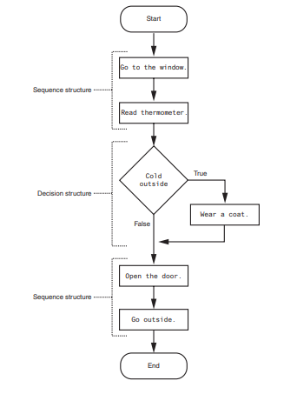
Nested Decision Structures and the if-elif-else Statement
To test more than one condition, a decision structure can be nested inside another decision structure.

Slide 13
1 # This program determines whether a bank customer
2 # qualifies for a loan.
3
4 MIN_SALARY = 30000.0 # The minimum annual salary
5 MIN_YEARS = 2 # The minimum years on the job
6
7 # Get the customer's annual salary.
8 salary = float(input('Enter your annual salary: '))
9
10 # Get the number of years on the current job.
11 years_on_job = int(input('Enter the number of ' +
12 'years employed: '))
13
14 # Determine whether the customer qualifies.
15 if salary >= MIN_SALARY:
16 if years_on_job >= MIN_YEARS:
17 print('You qualify for the loan.')
18 else:
19 print(f'You must have been employed '
20 f'for at least {MIN_YEARS} '
21 f'years to qualify.')
22 else:
23 print(f'You must earn at least RM'
24 f'{MIN_SALARY:,.2f} '
25 f'per year to qualify.')
Program Output (with input shown in bold)
Enter your annual salary: 35000
Enter the number of years employed: 1
You must have been employed for at least 2 years to qualify
.
Program Output (with input shown in bold)
Enter your annual salary: 25000
Enter the number of years employed: 5
You must earn at least RM 30,000.00 per year to qualify.
Program Output (with input shown in bold)
Enter your annual salary: 35000
Enter the number of years employed: 5
You qualify for the loan.

Slide 14
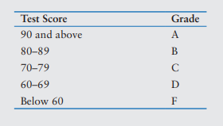
eXercise:
Dr. Suarez teaches a literature class and uses the following 10-point grading scale for all of his exams:
He has asked you to write a program that will allow a student to enter a test score and then display the grade for that score. Here is the algorithm that you will use:
1. Ask the user to enter a test score.
2. Determine the grade in the following manner:
If the score is greater than or equal to 90, then the grade is A.
Else, if the score is greater than or equal to 80, then the grade is B.
Else, if the score is greater than or equal to 70, then the grade is C.
Else, if the score is greater than or equal to 60, then the grade is D.
Else, the grade is F

Slide 15
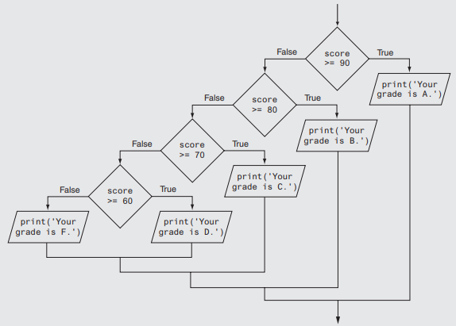

Slide 16
1 # This program gets a numeric test score from the
2 # user and displays the corresponding letter grade.
3
4 # Named constants to represent the grade thresholds
5 A_SCORE = 90
6 B_SCORE = 80
7 C_SCORE = 70
8 D_SCORE = 60
9
10 # Get a test score from the user.
11 score = int(input('Enter your test score: '))
12
13 # Determine the grade.
14 if score >= A_SCORE:
15 print('Your grade is A.')
16 else:
17 if score >= B_SCORE:
18 print('Your grade is B.')
19 else:
20 if score >= C_SCORE:
21 print('Your grade is C.')
22 else:
23 if score >= D_SCORE:
24 print('Your grade is D.')
25 else:
26 print('Your grade is F.’)
Program Output (with input shown in bold)
Enter your test score: 78
Your grade is C.
Program Output (with input shown in bold)
Enter your test score: 84
Your grade is B.

